Slide 1

A TRICS
Project Update
Owen Edwards, Project Manager, TRICS Consortium Limited
Notes:
In this presentation, I’m going to run through a brief update of the TRICS project, including how things have gone in 2023 and what’s planned for 2024. I will cover various elements of the project including regional data collection programmes, SAM surveys, the TRICS Bureau Service and system development.

Slide 2
2023 Data Collection Programme
269 surveys in the 2023 Regional Data Collection Programme.
13% increase from the 2022 Regional Data Collection Programme.
137 Level 1 (vehicles only) surveys and 132 Level 2 (multi-modal) surveys.
60 different land uses covered across 17 regions.
Notes:
Firstly, let’s look at the 2023 Data Collection Programme. The programme as it stands consists of 269 surveys, which is a 13% increase from the 2022 programme. Of these, there are 137 Level 1 (vehicles only) surveys and 132 Level 2 (multi-modal) surveys. There are over 100 active land use sub-categories in TRICS, and in 2023 we have covered 60 of these.

Slide 3
2023 Data Collection Programme
All surveys will be undertaken by Thursday 30th November, as this is the end of the Autumn survey window.
193 surveys have been received from our data collection contractors, with more to follow.
Approximately 100 surveys from 2023 have been fully validated or are in the final stages of this process.
Notes:
All 269 surveys will have been undertaken by Thursday 30th November, the date when the Autumn survey window closes. So far, 193 of these surveys have been received by TRICS from our various data collection contractors. Approximately 100 of these surveys have been fully validated or are in the final stages of validation testing, ready to be added to the live TRICS database.

Slide 4
2024 Data Collection Programme
270 surveys planned for the 2024 Regional Data Collection Programme (120 Level 1 surveys and 150 Level 2 surveys).
This is an identical initial target to the 2023 programme.
57 different land uses to be covered across 17 regions.
Several land uses have returned to the programme following the 2023 TRICS User Survey.
Notes:
Looking ahead to the 2024 Data Collection Programme, there are 270 surveys planned, which is an identical initial target to the 2023 programme, broken down into 120 Level 1 surveys and 150 Level 2 surveys). These 270 surveys will be spread across 57 different land uses, with several sub-categories returning to the programme for 2024 following our analysis of the 2023 TRICS User Survey. Some of the more significant land uses returning to the programme for 2024 include 01/A (Food Superstore), 02/A (Office) and 03/A (Houses Privately Owned).

Slide 5
2024 Regional Surveys Land Uses
Notes:
This pie chart shows the breakdown of the different main land use categories planned for the 2024 Regional Data Collection Programme. All TRICS regions are also shown on the map, and as always, we will be covering each region with specific programmes through 2024.

Slide 6
2024 Data Collection Programme
Site visits have already taken place in 9 regions for surveys in 2024.
Permissions gathering is underway.
The first regions of Level 2 (multi-modal) surveys will be tendered and awarded in early 2024, with others tendered and awarded through the year.
All Level 1 (vehicles only) survey regions to be tendered and awarded in January 2024.
Notes:
Preparations for the 2024 Data Collection Programme began back in August this year with the first rounds of regional site visits taking place. In total, there have been 9 weeks of regional site visits for the 2024 programme so far. Some of the places that the team have visited have included Belfast and Antrim in Ulster (Northern Ireland), Grantham and Louth in the East Midlands, the Isle of Man and Northwich in the North-West, Galway in Connaught, Letterkenny in Ulster (Republic of Ireland), Eastbourne in the South-East, Rhyl and Wrexham in Wales, and Carlisle and Penrith in the North. Permissions gathering for these nine regions is currently in progress. The first regions of Level 2 (multi-modal) surveys will be tendered and awarded in early 2024, with all Level 1 (vehicles only) regions tendered and awarded in January 2024.

Slide 7
2024 Data Collection Programme
New working arrangement between TRICS and Transport for London, helping to focus some of the Greater London site visits towards developments of most interest.
TRICS also engaging local authorities elsewhere around the country to obtain endorsement notes.
TRICS is always open to suggestions for developments to be surveyed.
Notes:
TRICS is pleased to announce that we now have a new working arrangement signed with Transport for London. This arrangement is in place to help focus some of the site visits undertaken within Greater London towards developments of most interest. All surveys taking place within Greater London will be multi-modal in nature, and TfL will regularly provide suggestions for developments where they would like to see TRICS surveys taking place (subject to permissions being granted by site operators). To assist in the permissions process, TfL have also provided a note endorsing TRICS surveys which can be used when our team contacts site operators. Such notes of endorsement are also being introduced in other areas through the TRICS team liaising with local authorities, so we hope this will further enhance the success of survey permissions gathering. At TRICS we’re always open to suggestions of good sites to survey, so if you have any recommendations, please do suggest them to us by sending them to our support@trics.org inbox.

Slide 8
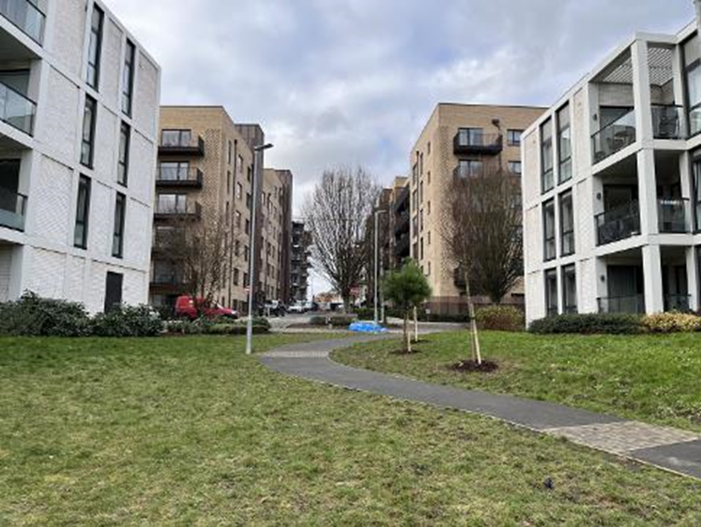
2023 SAM Surveys
A record 68 SAM surveys commissioned in 2023 (53 outside Greater London and 15 within Greater London).
There were 54 SAM Surveys commissioned in 2022 (36 outside Greater London and 18 within Greater London).
SAM survey requests coming in for new areas (for example Nottinghamshire, Dorset, Hertfordshire, Oxfordshire).
Continued high numbers of SAM surveys expected in 2024.
Notes:
Moving on to the 2023 SAM programme of separately commissioned surveys, there have been a record 68 SAM surveys commissioned this year. Of these, 53 are located outside Greater London and 15 are located within Greater London. To put these numbers into context, there were 54 SAM surveys commissioned in 2022, so there has been a 20% increase in 2023. We are also starting to see more SAM requests coming in from new areas such as Nottinghamshire, Dorset, Hertfordshire and Oxfordshire, with interest also coming from other areas. This is a good sign, and we do expect continued high numbers of SAM commissions in 2024.

Slide 9
SAM Process Presentations/Event
SAM Process Presentations offered free to TRICS member organisations in 2023 and were popular. These remain offered in 2024.
Potential for SAM Workshop Day event in 2024. Could consist of series of presentations going into more detail, including site visits and specifications, the Travel Plan data section, provision of supporting data and SAM case studies.
Would you be interested?
Notes:
In 2023 TRICS offered free in-person presentations on the SAM process, and this offer was taken up by numerous TRICS member organisations. These are free presentations, designed to provide organisations who may be getting involved in SAM surveys with detail of the process of SAM commissions from start to finish. The offer of these presentations remains going into 2024, so if you are interested in this please contact us here at TRICS. Another idea that we have is a potential SAM Workshop Day event in 2024. This could consist of a series of interactive presentations that go into more fine detail and could cover the SAM process in specific areas such as site visits and survey specifications, the Travel Plan data section, the collection and provision of supporting information needed to populate the TRICS database for SAM surveys, and some SAM survey case studies. I would like to ask how many of you here would be interested in attending such an event.

Slide 10
TRICS Bureau Service
The TRICS Bureau Service allows non-member organisations to purchase TRICS data and sets of calculation results.
Year | Licence | Vehicles Only | Multi Modal | Rank Order
2022 | 8 | 48 | 25 | 6
2023 to Date | 8 | 46 | 17 | 8
Notes:
Next, let’s look at the TRICS Bureau Service. This service is provided to enable the purchase of specific TRICS data and sets of calculation results when required by non-member organisations. In effect, the TRICS team acts as the user on behalf of those wishing to acquire data, applying the client’s selection criteria. The popularity of the TRICS Bureau Service has remained approximately the same in 2023 compared to last year. There are two tiers of Bureau Service fees, one for Bureau Service users who pay an annual fee (with cheaper data rates) and another for those who do not and would normally use the service only very infrequently. The number of Bureau Service licences purchased has been the same in 2023 as in 2022. There have been less fulfilled multi-modal data requests in 2023 but there is still a month to go, so we do expect this number to be nearer the 2022 figure come the end of the year.

Slide 11

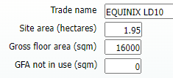

2023 System Developments
System developments have been slightly fewer this year due to preparation work for TRICS 8.
A few new features have been added to TRICS during the year and there will be more for 7.10.4.
Notes:
Development of the TRICS software is a big part of what we do and you, the users, play a big role in this area. There have been slightly fewer system developments in TRICS this year due to preparation for the development of TRICS 8. However, a few new features have been added to the system in 2023 and there will be a few more for the release of TRICS 7.10.4 towards the end of December. We can see three examples on this slide, which include displaying the number of on-site electric vehicle charging bays at petrol filling stations, the split between indoor and outdoor seats for developments such as cafés and restaurants, and the introduction of surveys at data centres. Our example shows the name and some basic details of a data centre in Slough. This year, TRICS has surveyed four data centres and originally (and temporarily) included them in the 02/A (Office) land use. However, it has been decided to move them to their own land use category, 02/I (Data Centre), which will go live in the December system update.

Slide 12
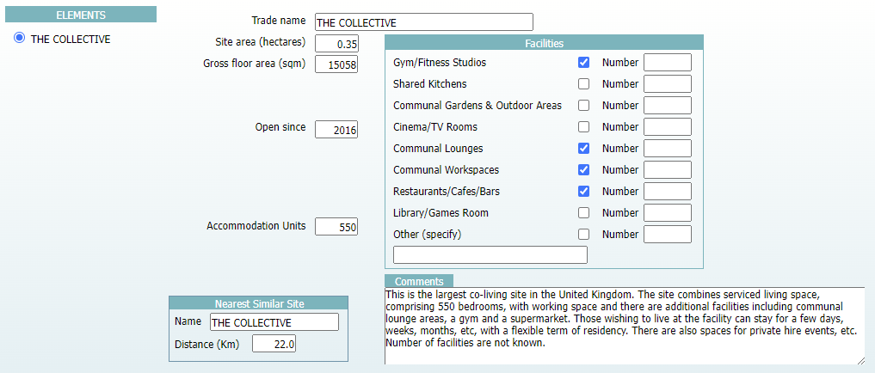
2023 System Developments
Added 03/Q (Shared Living Developments) Land Use Sub-Category.
Notes:
A significant system development during 2023 has been the addition of the 03/Q (Shared Living Developments) land use sub-category. The definition of this sub-category is as follows: “Apartment developments with additional integrated and communal facilities. Residential units can be rented directly with varying and flexible lengths of occupancy (including short term). Additional facilities may include gyms/fitness studios, shared kitchens, communal lounges, gardens and outdoor areas, cinema/TV rooms, communal workspaces, restaurants/cafes/bars, and other uses such as libraries and games rooms, etc. Trip rates are calculated by Accommodation Units or Gross Floor Area.” In the screenshot it’s possible to see different features which could be found at these developments, with tick boxes to show their presence on-site at the time of the survey. The example shown is from several years ago, with this site now moved into the new sub-category. The plan is to survey more of this type of development in 2024.

Slide 13
2023 System Developments
Annual TRICS review of local government restructuring, with the TRICS database updated with new area codes when necessary and sites moved into new areas.
Notes:
Recently, there have been numerous changes to local government structures, and this is reflected in the TRICS software. Each local planning authority is designated its own area code, which features in each TRICS site reference code as the first two letters. This year, TRICS needed to reassign many surveys in both the Yorkshire & North Lincolnshire and North regions to new reference codes as several of the larger local authorities were transformed into new unitary authorities. In 2023, in the North region, Cumbria County Council has been replaced by the two new unitary authorities of Cumberland and Westmorland & Furness, and, in the Yorkshire & North Lincolnshire region, the South Yorkshire TRICS area has been replaced by the unitary authorities of Sheffield, Barnsley, Doncaster and Rotherham. North Yorkshire remains, but the new unitary authority of York has been introduced, and the West Yorkshire area has been replaced by the unitary authorities of Bradford, Calderdale, Kirklees, Leeds and Wakefield. Looking ahead to 2024, we can see that no further changes are happening, which is a nice relief!

Slide 14
2023 System Developments
Comprehensive update of the TRICS Travel Plan Monitoring Report Facility (TPMR).
Notes:
Following the major update to the TRICS Travel Plan data section in 2022, we have also undertaken a full review and update of the TRICS Travel Plan Monitoring Report (TPMR) facility, which went live in version 7.10.3 of TRICS at the end of September 2023. However, I won’t say any more as there is a separate presentation all about this later today.

Slide 15
TRICS 8 Upgrade & Redesign
Preliminary work on TRICS 8 has begun.
Stage 1: A like-for-like “mirrored” system in a new programming language so that TRICS 7 and TRICS 8 can be fully tested and debugged.
Stage 2: Variety of new system features and enhancements introduced before TRICS 8 goes live.
Work on Stage 1 commences in early 2024.
No additional charges for TRICS users.
Notes:
I can also provide an update on the development of TRICS 8, which is a major upgrade and redesign of the system. Preliminary work has taken place this year, and Stage 1 of this project will commence in early 2024. This will be a mirrored “like-for-like” system in a new programming language, so that testing between TRICS 7 and TRICS 8 can take place and all bugs subsequently removed. Stage 2 of the project will follow this and is where we will introduce a variety of new system enhancements and features, with the first version of TRICS 8 then going live for all our users. None of the costs involved in this major upgrade and redesign will be passed on to our users. Due to a new system developer needing to be sourced, the target for the first version of TRICS 8 becoming available is mid-2025, with the 2025 TRICS Training & Development Forum being the plan for the formal launch day of the new system. We will keep everyone informed of progress, but in 2024 this is our highest focus.

Slide 16
2024 Training & Development Forum
2024 TRICS Training & Development Forum venue soon to be sourced.
2023’s event was in Nottingham, with previous locations including Oxford, Birmingham, Newcastle and York.
The TDF is more of a TRICS technical event, with the User Meeting encompassing the wider project.
Set to take place in June 2024, and further details will follow.
Notes:
What better time to talk a little bit about the Training & Development Forum events. The 2024 Training & Development Forum will take place next June, and as previously announced this regional event will be held annually in June whilst the User Meeting continues to take place in November in London. We will very soon decide on the venue of the 2024 event, with previous locations having included Nottingham last year plus Oxford, Birmingham, Newcastle and York. We shall provide everyone with further information once we have sourced the venue and agreed the event’s date. As always, the Training & Development Forum is more of a technical TRICS system event, with the User Meeting encompassing the TRICS project on a wider scale.

Slide 17
Updates to Guidance Documents
Annual updates of TRICS guidance documents to go live in December (TRICS version 7.10.4).
Updated TRICS Good Practice Guide.
Updated Multi Modal Methodology.
Updated Use Class and Land Use table.
Notes:
Looking ahead to 2024 and beyond, every year we update the important TRICS guidance documentation and publish these updates for our users. For 2024 there have been some minor revisions to the TRICS Good Practice Guide and the TRICS Multi Modal Methodology documents. These will be available on the TRICS website and within the TRICS software from 22nd December, the release date of TRICS version 7.10.4. There will also be some minor revisions to other documents and guidance notes found in the TRICS software. For example, there will be an updated Use Class and Land Use table (to include the two new land use sub-categories in TRICS mentioned earlier).

Slide 18
TRICS Research Projects
TRICS team restructuring will allow for a new approach to undertaking TRICS research projects.
Development of a research strategy to instigate research projects.
Integrating Decide & Provide within TRICS 8.
Your ideas for research are welcomed, with the annual TRICS User Survey going out early in 2024.
Notes:
Finally, I’d like to speak briefly about research projects here at TRICS. The restructuring of the TRICS team, which took place in October this year, will allow for a new approach to undertaking TRICS research projects. Such projects and technical analyses of the data within TRICS add great value to TRICS, and we want to move these forwards in 2024. It has been a while since TRICS was able to carry out larger research projects, with most output in recent years confined to small research projects and the production of technical notes. Plans for 2024 include the development of a research strategy to instigate research projects covering various areas, and the integration of Decide & Provide within TRICS 8. We would also like to hear your ideas for TRICS research, and the TRICS User Survey will be going out to all user organisations early in 2024, so please take part and have your say in the future of the project.

